Slide 1
Passenger Dissatisfaction on Invistico Airline
Notes:
(TURN ON CAMERA) Good afternoon , First of all Thank you mr … for gave me the opportunity to present my milestone regarding Passenger Dissatisfaction on Invistico Airline

Slide 2
01
Problem

Slide 3
Problem
An airline company called Invistico Airline is experiencing a decline in customer trust and company revenue.
The company leader ordered the Data Team to find out the characteristics of customers who were dissatisfied with Invistico Airline's services and the causes of customer dissatisfaction.
Notes:
At this milestone I define the issue into:
An airline company called Invistico Airline is experiencing a decline in customer trust and company revenue.
The company leader ordered the Data Team to find out the characteristics of customers who were dissatisfied with Invistico Airline's services and the causes of customer dissatisfaction.

Slide 4
About Data
02

Slide 5
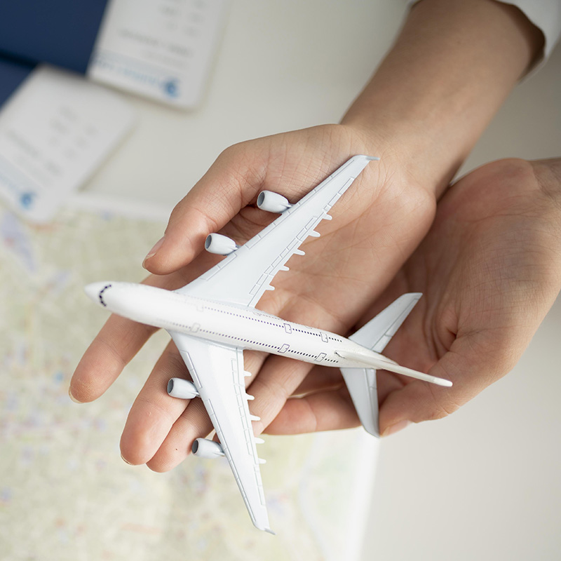
Dataset Information
Source : Kaggle (https://www.kaggle.com/datasets/teejmahal20/airline-passenger-satisfaction)
129448 rows data (after cleaned)
22 columns
Notes:
I took the dataset from Kaggle with the link displayed on your screen.
After cleaned, raw data has shape one hundred twenty-nine thousand four hundred and forty-eight rows and twenty two columns.

Slide 6
Data Processing
03

Slide 7
Flow Process
PostgreSQL
Data Cleaning
By Apache Airflow
Kibana Visualization
Dataset inserted to postgreSQL
Fetch From PostgreSQL
Insert to Elasticsearch
By Apache Airflow
By Apache Airflow
Notes:
In data processing, airflow is used to help schedule and process data flow. Data is set every six thirty. And the flow process starts by inputting the dataset into PostgreSQL, then fetching the data from PostgreSQL using Airflow, then the Data Cleaning stage includes handling duplicates, changing to lowercase, changing spaces to undercase, deleting symbols, and deleting missing values. Then insert into elasticsearch and visualize using Kibana

Slide 8
Visualization
04

Slide 9
Overall comparison
54,74%
SATISFIED
45,26%
DISSATISFIED
Notes:
- From the first plot we can see that there are more satisfied passengers than dissatisfied passengers. However, there is very little difference in numbers.
This fact is very dangerous for the Invicto Airlines airline, because high levels of dissatisfaction can threaten customer trust in choosing Invicto Airlines.
- In the book "Harvard Business Review Entrepreneur's Handbook" (2017), it is explained that the maximum limit of customer dissatisfaction that is considered reasonable or acceptable is only around 5-10%.

Slide 10
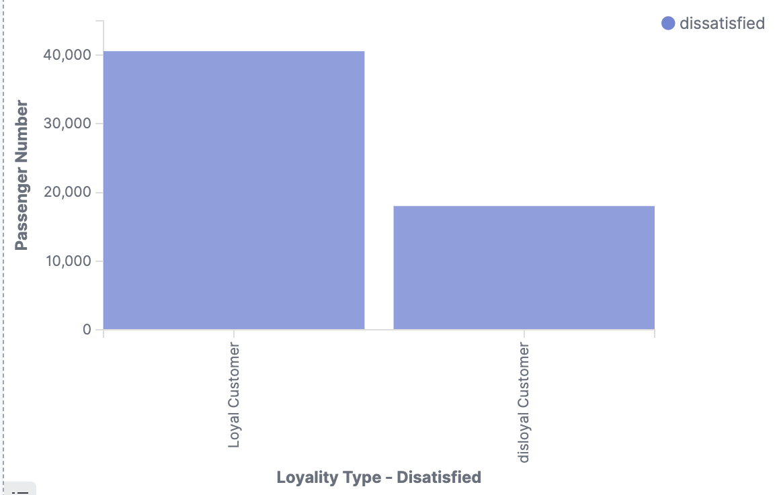
Comparison of loyal customers with disloyal customers who are dissatisfied with Invicto Airlines
Notes:
((SCROLL))
This plot shows the comparison of loyal customers with disloyal customers who are dissatisfied with Invicto Airlines
- Passenger dissatisfaction is more dominated by loyal customers than disloyal customers. Logically, most loyal customers have loyally used airplanes as their transportation. So, they really know the excellent service from an airline, but they also know about the poor service from an airline.
- Invicto Airline is a Low Cost Carrier (LCC) company, most LCC airlines will open many flight routes, we assume that loyal customers will continue to use Invicto Airline because in their departure area or destination area there are not many airline options. This is exactly what happened to Lion Air in Indonesia
- From the references I took with the title “Impact of Service Quality of Low-Cost Carriers on Airline Image and Consumers Satisfaction and Loyalty”
LCC airline has loyal customers for business purposes. Their company has contracted with low-cost airlines and which has various routes.

Slide 11
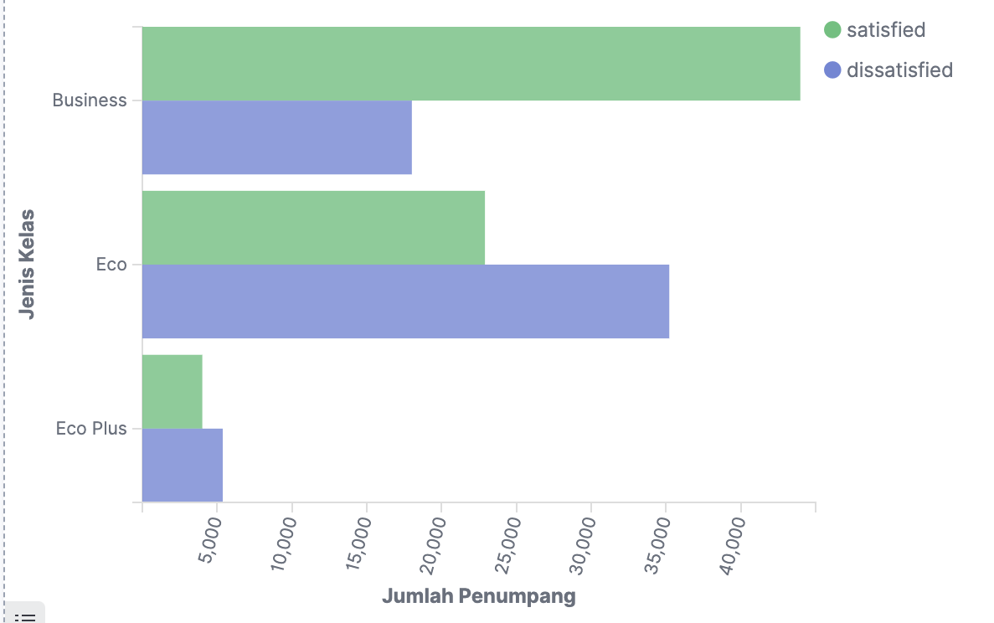
comparison of the number of dissatisfied and satisfied customers from service class types.
Notes:
((Scroll))
The third plot shows a comparison of the number of dissatisfied and satisfied customers from service class types.
there are more passengers in business class than economy and economy plus class. However, most customer economy passengers are dissatisfied with Invicto Airline services.
Economy passengers have many service restrictions, such as limited baggage, free meal service, seat comfort, waiting areas, and other limited services.
From the book "Aviation Business in Indonesia" (2008). There is a statement which states that limited services make passengers uncomfortable. Compared to other available transportation services, airplanes are very strict in limiting all services provided. This will make passengers uncomfortable

Slide 12
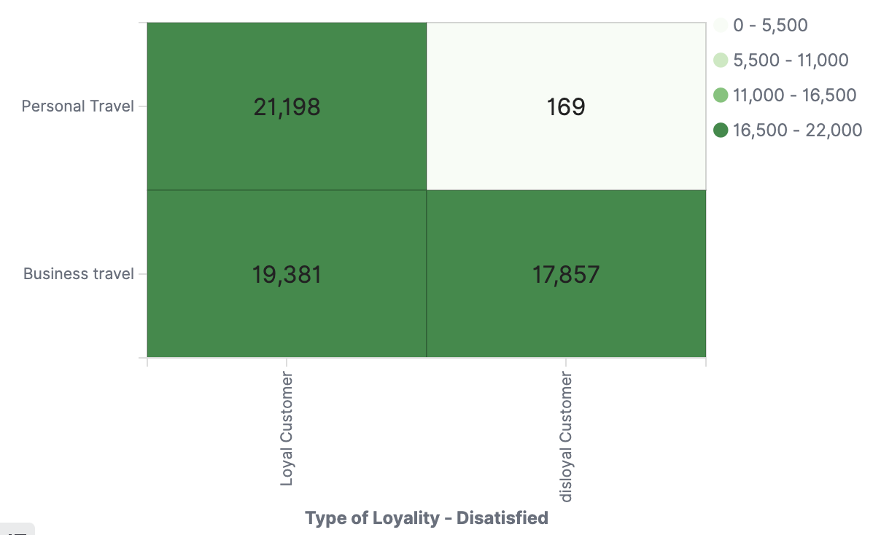
The type of customer loyalty that is dissatisfied with its travel purpose.
Notes:
((Scroll))
This plot shows the type of customer loyalty that is dissatisfied with its travel purpose.
Of the total loyal and disloyal, customers with business travel purposes are most dissatisfied. This is assumed because they are traveling on stressful work matters, they expect better service than which provided and more sensitives emotion.
Customers with personal travel purposes are in second place, this happens because generally passengers have personal travel purposes such as holidays, returning to their hometown, honeymoons and other personal purposes. So they have higher tolerance and travel in a good mood than passengers with business purposes.
Another reason is, that passengers with business purposes are thought to use Invicto Airline more often. They are more detailed in seeing weaknesses in Invicto Airline service because they occur repeatedly.

Slide 13
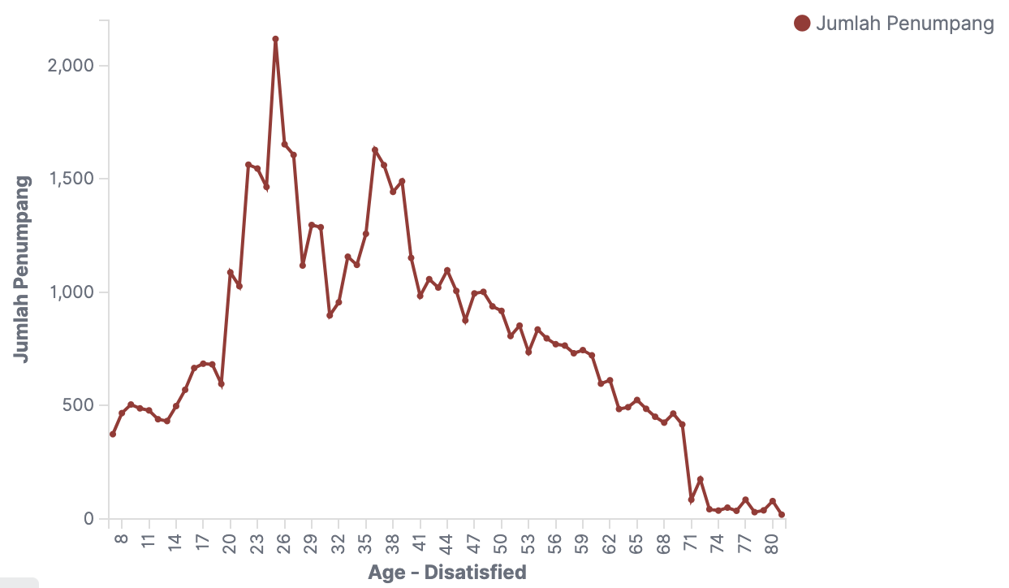
Comparison of the number of dissatisfied and satisfied customers from service class types.
Notes:
((SCROLL))
From the 5th plot we can conclude that customers who are dissatisfied with Invicto Airlines services are customers with aged 25 years.
Judging from the graph, customers with ages starting from 20 years continue to increase until they peak at 25 years. This is in line with the statement by clinical psychologist, Lisa Marielly Djaprie (2022) that emotional and mental maturity will be formed after the age of 25. In 25 years are the peak period for critical thinking abilities and emotion stablities.
Invicto airline customers are mostly 25-40 years old. Statistically, if higher the population of a group is higher the possibilities of dissatisfied.
All Invicto staff need to differentiate their service methods and respond of complaints based on age.

Slide 14
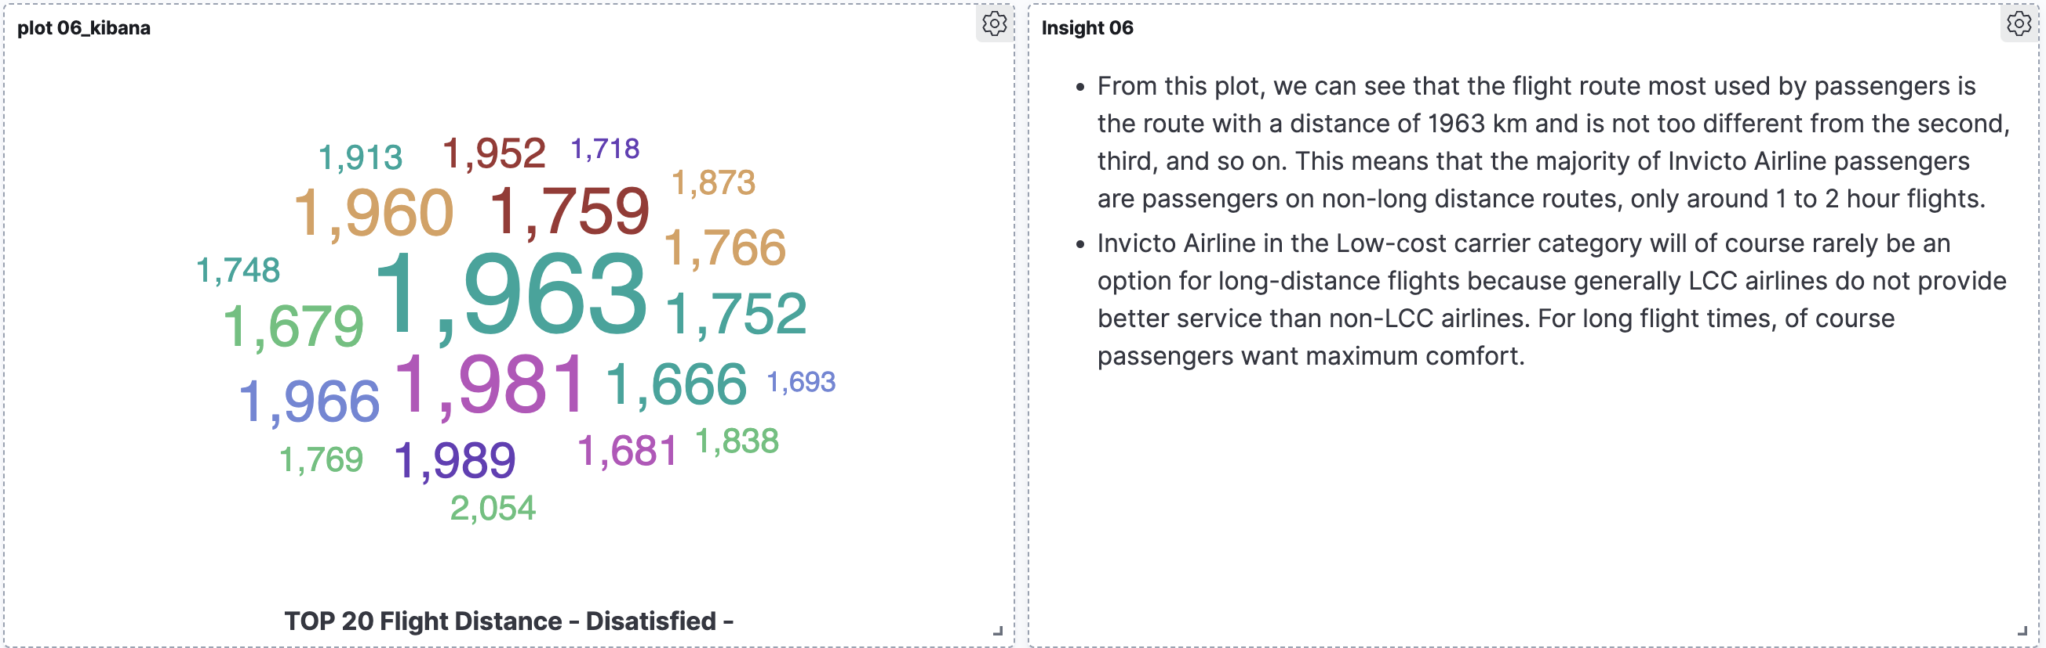
TOP 20 FLIGHT DISTANCE - DISATISFIED
Notes:
From this plot, we can see that the flight route most used by passengers is the route with a distance of one thousand nine hundred and sixty three kilometer and is not too different from the second, third, and so on. This means that the majority of Invicto Airline passengers are passengers on non-long distance routes, only around 1 to 2 hour flights.
Invicto Airline is the Low-cost carrier category. Of course, passengers with long-distance route not choose Invicto Airline because they want maximum comfort.

Slide 15
Average of Rating Services
2.839
2.852
2.99
2.99
Seat Avg Rating
Food Service Avg
Rating
Time Convenient Avg Rating
Gate Location Avg Rating
3.249
3.353
3.341
3.384
Wi-fi Avg Rating
Check-in Avg Rating
Inflight Ent Avg Rating
Online Boarding Avg Rating
3.465
3.472
3.486
3.52
On Board Service Avg Rating
Online Booking Avg Rating
Leg Room Avg
Rating
CS OL Support
Rating
3.695
3.706
Baggage Handling Avg Rating
Cleanliness Avg Rating
Notes:
- Previously from first plot until sixth plot, we discussed the characteristics of customers who dissatisfied with Invistico Airline's services. But in this plot, we will discuss the causes that make them dissatisfied.
- From the average rating, we can see, that seating comfort is the big problem for Invistico Airline, then food service and time convenient.
- The best service from Invistico Airline is cleanliness, baggage handling, and customer service online support.
- In general, the average service rating of Invistico Airline is very low. we need transformation in all services sector to increase customer trust which will have an impact on increasing company revenue

Slide 16
Conclusion
05

Slide 17
Conclusion
﻿﻿
In general, Invistico Airline passengers were dissatisfied is fourty five point twenty six percent of the total passengers.
﻿﻿Passenger dissatisfication is more dominated by loyal customers than disloyal customers.
﻿﻿Most customer economy passengers are dissatisfied with Invicto Airline services.
Customer or passenger with business travel purposes are most dissatisfied.
﻿﻿Customers with ages starting from 20 years continue increase until they peak at age 25. Invicto Airline staff need differentiate method to handling customer complain by age.
﻿﻿The majority of Invicto Airline’s disatisfied passengers are passengers on non-long distance routes, only around 1 to 2 hour flights.
﻿﻿Seating comfort is the main problem for Invistico Airline, then food service and time convenient.
﻿﻿In general, the average service rating of Invistico Airline is very low. There is a need for service transformation from all sectors to increase customer trust which will have an impact on increasing company revenue
Notes:
﻿﻿((SCROLL))
In general, Invistico Airline passengers were dissatisfied is fourty five point twenty six percent of the total passengers.
﻿﻿Passenger dissatisfication is more dominated by loyal customers than disloyal customers.
﻿﻿Most customer economy passengers are dissatisfied with Invicto Airline services.
Customer or passenger with business travel purposes are most dissatisfied.
﻿﻿Customers with ages starting from 20 years continue increase until they peak at 25 years.
Invicto Airline staff need differentiate method to handling customer complain by age.
﻿﻿The majority of Invicto Airline’s disatisfied passengers are passengers on non-long distance routes, only around 1 until 2 hour flights.
﻿﻿Seating comfort is the main problem for Invistico Airline, then food service and time convenient.
﻿﻿In general, the average service rating of Invistico Airline is very low. There is a need for service transformation from all sectors to increase customer trust which will have an impact on increasing company revenue

Slide 18
THANK YOU!
Notes:
That’s all, thank you!

